Slide 1
SAP Sales and Distribution Project
Presented By:
1070868 - Mahima Agrawal
1070865 - Pritam Dhake
1070864 - Amit Kumar
1070867 - Amey Nikhare

Slide 2
Milkegy Pvt. Ltd.
Milkegy is an Indian co-operative dairy company.
The cooperative milk marketing federation manufactures Dairy products manufactured from fresh cow milk .
Our company manufactures almost 10-12 value-added milk products.

Slide 3
Milkegy Pvt. Ltd. Structure
Company code
ZT01
Sales Organization
ZT01
Plant
ZT01
Division
ZT
Distribution Channel
ZT
Storage Location
BLR – JP 01
Shipping Point

Slide 4
LIST OF DOCUMENTS AND PROCESS FLOW
INQUIRY
QUOTATION
SALES ORDER
RETURNS
DELIVERY
BILLING DOCUMENT

Slide 5
Customers
These are our customers.
Internal Numbering | External Numbering
DMart ( DMART99 ) | 201689 ( Reliance Fresh )
Bigbazaar ( BIGBAZAAR )

Slide 6
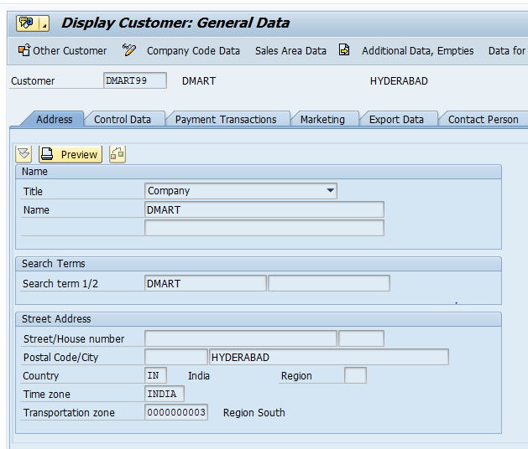
external numbering for Dmart99

Slide 7
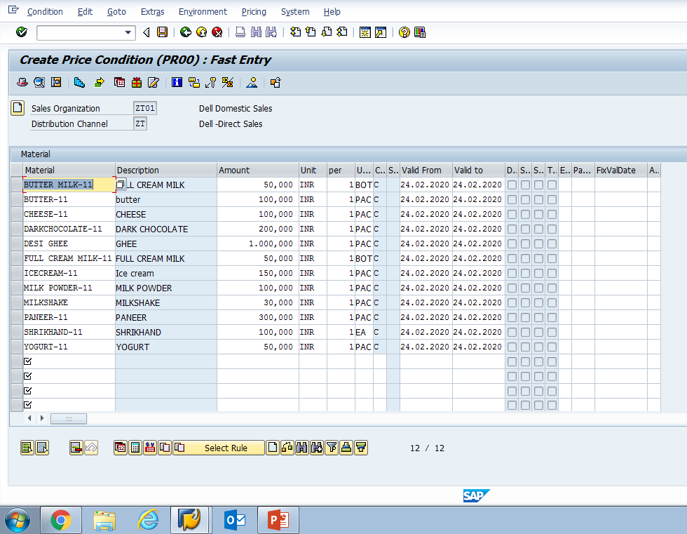
Materials
FULL CREAM MILK-11
PANEER-11
YOGURT-11
Desi ghee-11
CHEESE-11
BUTTER MILK-11
MILK POWDER-11
SHRIKHAND-11
DARK CHOCOLATE
MILKSHAKE
BUTTER-11

Slide 8
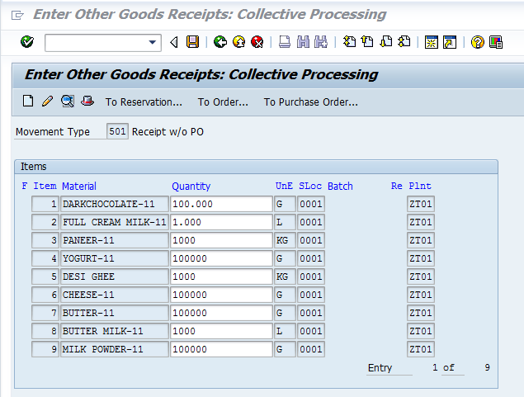
Material STOCK
Transaction code for Adding Stock :(MB1C)

Slide 9
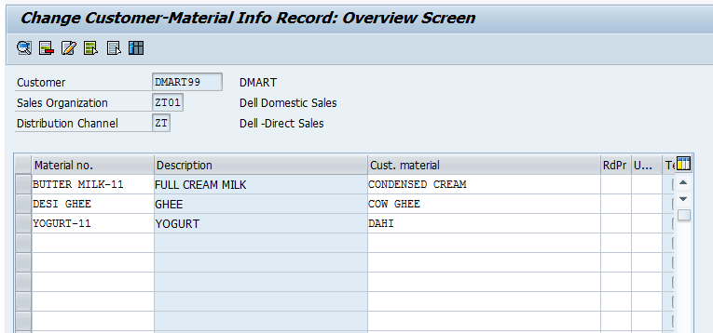
Customer Master Info record
CMIR for DMart99

Slide 10
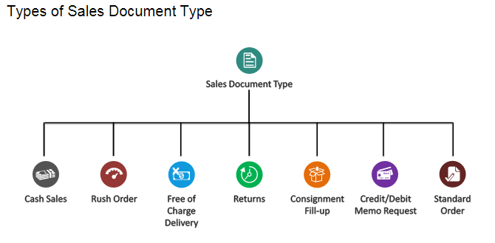
Sales Document –Sales Order
A Standard Sales order is created based on Inquiry of customer regarding some of the items.
Sales order is a legal agreement for the supply of services or products for a specified quantity in certain period of time.

Slide 11
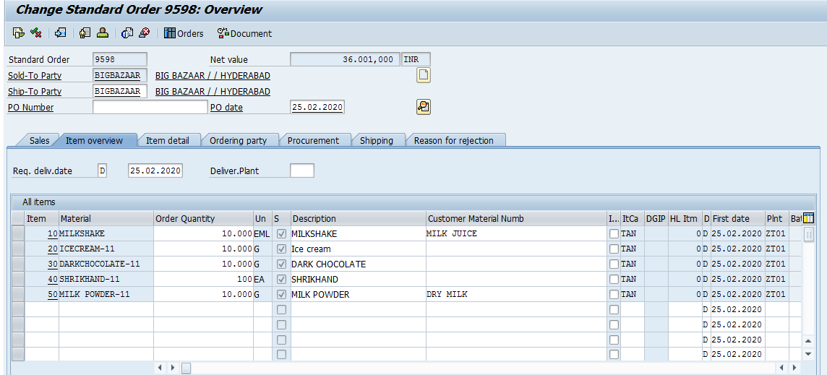
Sales Order
Sales order is a legal agreement for the supply of services or products for a specified quantity in certain period of time.
Signed between sales organization and a customer

Slide 12
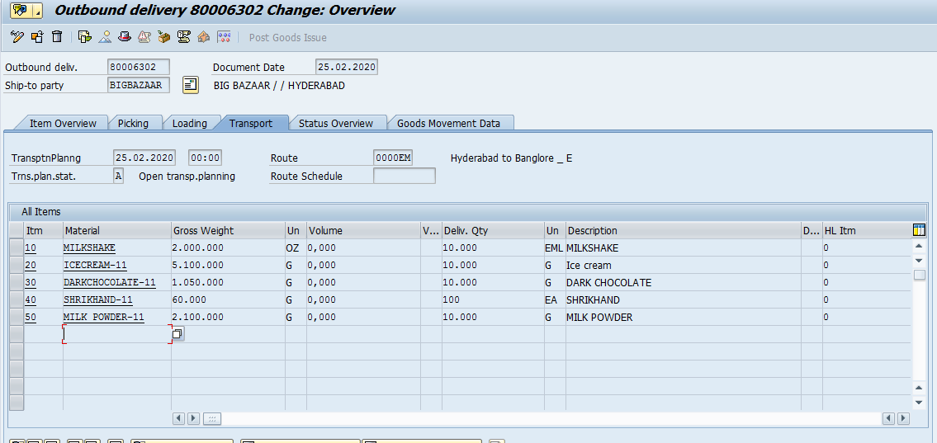
Delivery document for sales order
The order is picked ,packed and PGI is done and the billing document is created.

Slide 13
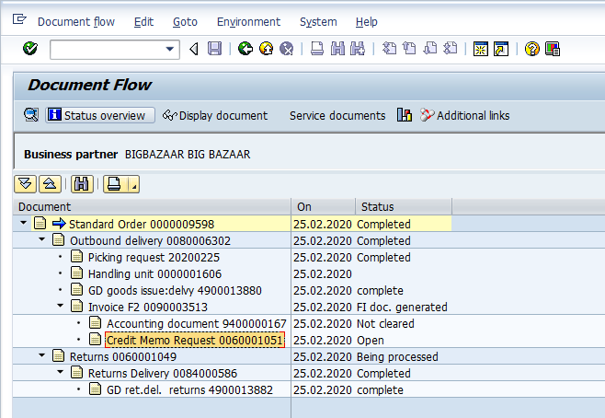
Document flow for SO
The document flow contains all the documents starting from standard order up to returns and credit memo.
Credit memo is different from returns in sense that here customer is credited without return of any goods.

Slide 14
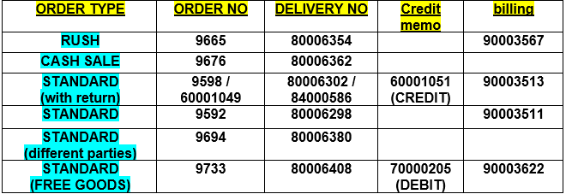
Documents created
Followings are the documents created in this Project.

Slide 15
Free goods
Business can consider to provide discounts in the form of free goods.
Item categories TAN and TANN are for standard item and free goods.
Free goods are determined based on the free goods master record.
Free goods can be of two types :
Inclusive Free Goods
Exclusive Free Goods

Slide 16
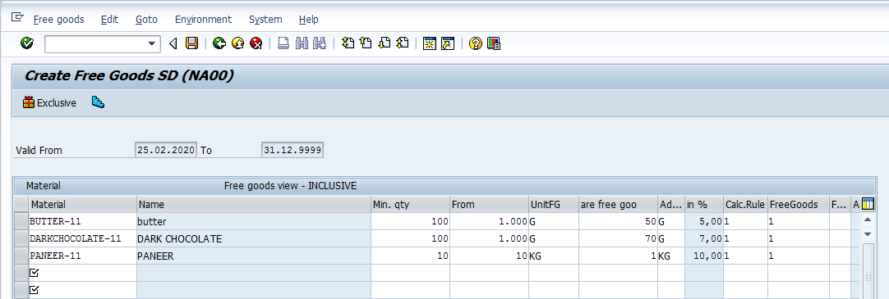
Inclusive Free goods
Part of the ordered quantity and not included in billing.
Ordered goods and free goods are the same material.

Slide 17
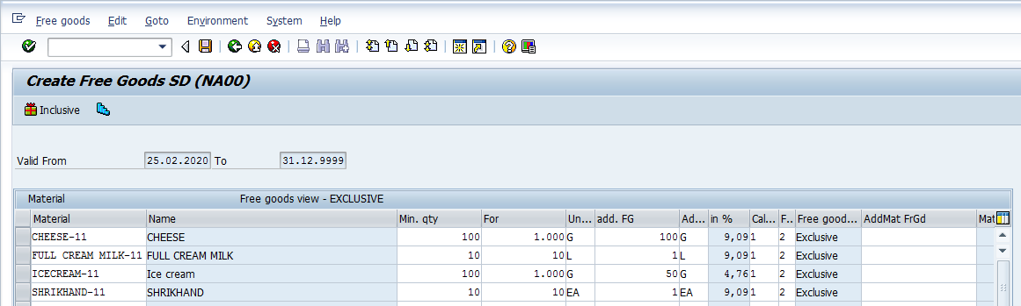
exclusive Free goods
Extra goods that are free of charge.
Extra goods are not included in the billing.
Ordered goods and free goods can be the same material or another material.
Exclusive Free Goods appear in the SD document as an individual, free-of-charge item.

Slide 18
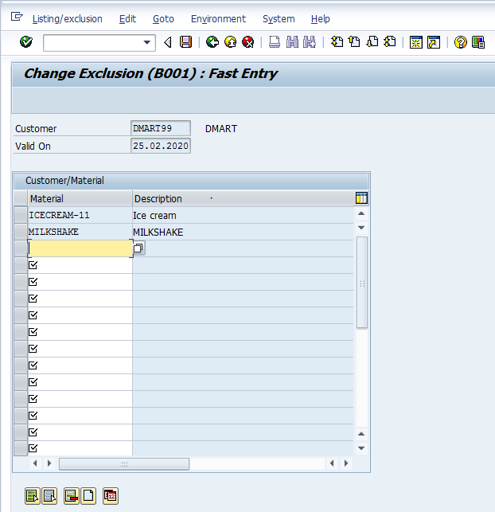
Material exclusion for customer
Some materials can be excluded or included for specific customers , this can be done using exclusion and listing in SAP.

Slide 19
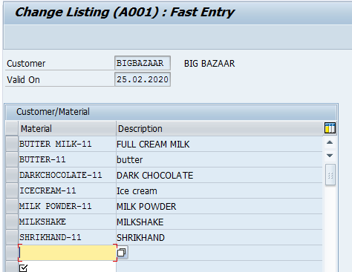
Material listing for customer
Used to list the products or services that specific Customers may or may not buy.
Listing includes the list of products for a particular customer and exclusion excludes the products a particular customer does not want.

Slide 20
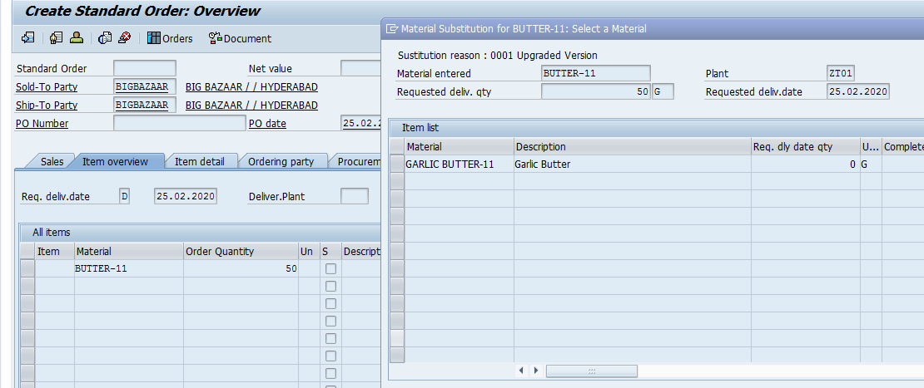
Material Determination
Material determination (also called Product selection) helps to automatically substitute an ordered materials with alternative(s) in sales documents
e.g. during Seasonal Promotions, special packaging, discounted material needs to be substituted by newer version .
This is valid for a specified period.

Slide 21
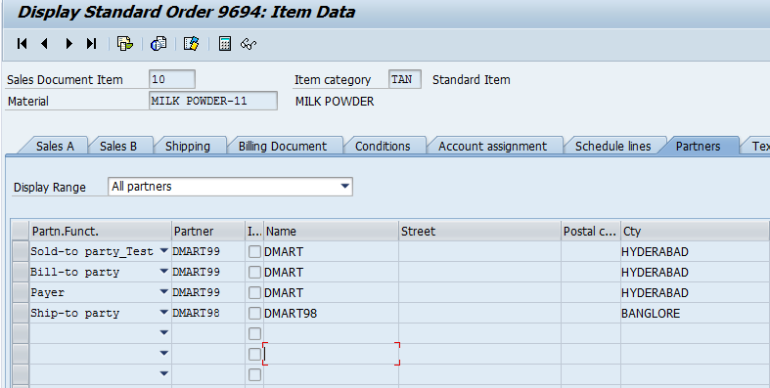
Different SHIP TO PARTY
AND SOLD TO PARTY

Slide 22
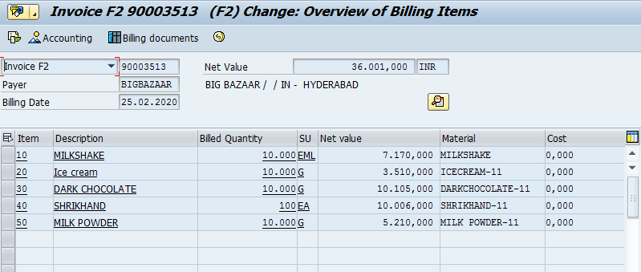
Billing
The billing document is created with the net value and total cost to be paid by customer.
In case of some returns a returns order(RE) is created and a credit memo may be issued to the customer

